Slide 1

Airline Reservation System

Slide 2

ABSTRACT
The Airport Authority System (AAS) was one of the earliest changes to improve efficiency.
ARS eventually evolved into the Computer Reservations System (CRS), and then into Global Distribution System (GDS).
The airline industry created the first GDS in the 1960s as a way to keep track of flight schedules, availability, and prices.
The airlines realized that by automating the reservation process for travel agents, they could make the travel agents more productive and essentially turn into an extension of the airline’s sales force.

Slide 3

OBJECTIVE
The objective of this project is to create a web application in Airline reservation system.

Slide 4



EXISTING SYSTEM
Traditional airline ticket booking systems rely on manual processes, where passengers have to visit physical counters or contact travel agents to book their flights. This outdated approach poses several challenges:
DISADVANTAGES:
No Real-Time Updates: Flight schedules and availability are not updated dynamically.
Limited Accessibility: Customers must visit physical locations or make phone calls to book tickets.
Manual Data Handling: Passenger details and flight records are managed manually, increasing the risk of errors.
Time-Consuming Process: Booking and modifications require considerable time.
Lack of Personalization: Users do not receive customized flight recommendations or offers.

Slide 5


Slide 6

ADVANTAGES
Faster System
Accuracy
Reliability
Informative
Reservations.

Slide 7

DISADVANTAGE
Manual work
Massive losses financially

Slide 8


PROPOSED SYSTEM
Our airline reservation system is a comprehensive web-based platform designed to streamline flight bookings, enhance user experience, and optimize administrative operations.
User Perspective:
1. Homepage Flight Search:
Users can search for available flights without logging in by entering details such as departure and destination cities, travel dates, and class preferences. This feature allows potential customers to explore flight options effortlessly.​
2. User Registration & Authentication:
To proceed with booking, users must create an account or log in. This ensures a personalized experience and secure management of bookings.​
3. Flight Booking Process:
Flight Selection: After logging in, users can select their preferred flight from the available options.​
Passenger Details: Users input necessary passenger information, ensuring accuracy for ticketing and compliance purposes.​
Seat Selection: The system provides an interactive seat map, allowing users to choose their desired seats based on availability.​
Payment Processing: Secure payment gateways facilitate transactions through various methods, including credit/debit cards and digital wallets.​
Ticket Issuance: Upon successful payment, the system generates an e-ticket in PDF format, which is immediately sent to the user's registered email address.​

Slide 9

ALGORITHM
Collaborative filtering

Slide 10
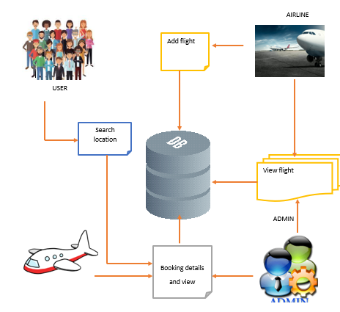
SYSTEM ARCHITECTURE

Slide 11
SYSTEM MODULE
In this project has Two Modules:
1.Admin
2.User

Slide 12

SYSTEM MODULE DESCRIPTION
Admin:
The admin has to Login into the account with the correct username and the password.
Add Flight: In this project we add flight. One is contains the flight related details
View Flight-- > View all details of flight
Booking Details:-->After view all booking details were it is booked by user.
View all feedback. -->View all feedback
Logout

Slide 13

user:
Login the account with the correct user name and password
Booking Details -->After view all booking details were it is booked by user.
View all feedback. -->View all feedback
Logout

Slide 14
SYSTEM REQUIREMENTS
HARDWARE REQUIREMENTS:
Processor | Intel(R) Core(TM) i5-7300U CPU @ 2.60GHz 2.71 GHz
Ram | 8.00 GB
Storage | 237GB (Hard disk)
System type | 64-bit Operating System, x64-based processor
Network | Stable internet connection

Slide 15
SOFTWARE REQUIREMENTS:
Operating System | Windows 10
Coding Language | JAVA
Front End | Net Beans Software
Back End | MySQLyog Community 32

Slide 16
CONCLUSION
Airports use a myriad of systems to support their operations. Many of those systems are now incorporating software, database, and network components.
They generate both on-demand and regular reports to assist airport management, improve operations and reduce cost at the same time.
In order for airports to become more effective and efficient in their operations, they need to understand the competitive advantage of these systems and how to align them together to better serve their stakeholders.
We successfully executed the web application in airline reservation system.

Slide 17
REFERENCE
Marks, A., Rietsema, K. and Hudson, G. (2013) Aviation Management Information Systems. Embry-Riddle Press.
Airport Cooperative Research Program (2008) Integrative Airport Information Systems—Report 13. Transportation Research Board.
Wensveen, J. (2007) Air Transportation: A Management Perspective. Ashgate.
Robert, K. (2008) Air Transportation. Kendall Hunt Publishing, 11.
Center for Air Transportation Systems Research (2009) Introduction to Airports Design and Operations. George Mason University

Slide 18

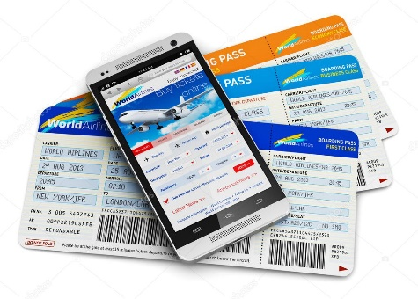


THANK YOU

